Slide 1
MWR Navy Cash
Introduction

Slide 2
What is Navy Cash
Navy Cash is a means to utilize an Electronic method for Payment of all items aboard U.S. Navy ships.
A card program was devised by Treasury to assist in this effort.
Navy Cash has been around since 2001… and is currently aboard 129 Ships and 43 barges.
(Ships with a ships store only)

Slide 3
Navy Cash Devices

Slide 4
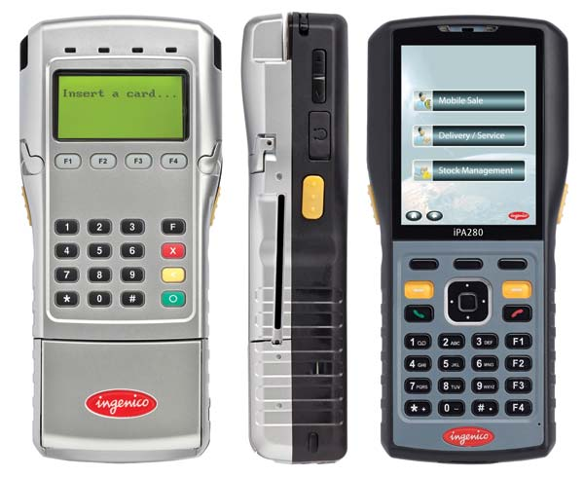
Ingenico (POS) Device (1471 System)
Perform sales and refund transactions on this unit at or in merchant locations, Disbursing, and with foreign vendors.
May be used in online or offline mode.
Functions in proxy mode (attached to computer) or normal mode (stand-alone).
Contains SD Card for redundancy.

Slide 5
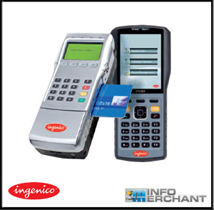
Ingenico (POS) Device (1471 System)
2Alphanumeric keyboards and 2 LED screens.
Two slots for cards (only the side slot is used).
Card must be inserted with back of device (silver side) facing you.
Keyboard on silver side of device is used by customer to enter PIN when making a transaction.

Slide 6
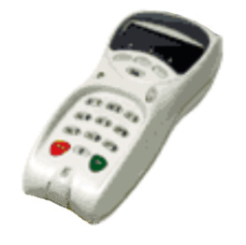
K22 Point of Sale (POS) Device (1463 System)
Perform sales and refund transactions on this unit at or in merchant locations, Disbursing, and with foreign vendors
May be used in online or offline mode
Functions in proxy mode (attached to computer) or normal mode (stand-alone)

Slide 7
K22 Point of Sale Device (1463 System)
Alphanumeric keyboard and LED screen
Two slots for cards (only the top slot is used)

Slide 8
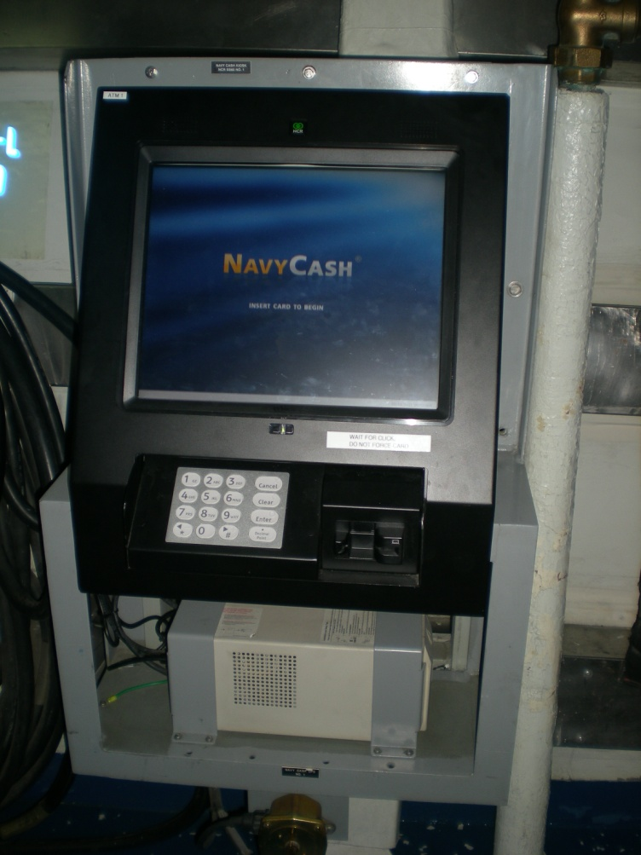
NCR Cashless ATM
Transfers money to and from chip, strip and home bank.
Must be online with connection to server in order to function.
Transactions are immediately logged with server.

Slide 9
Navy Cash Accountable Official
Navy Cash merchant cards must only be issued to accountable officials who are authorized to use Navy Cash in an official capacity. Navy Cash accountable official cards are not for personal use
As accountable officials, Navy Cash merchants must complete and sign an FMS Form 2888 (09-13), Accountable Official Application Form for U.S. Department of the Treasury Stored Value Card (SVC), prior to being issued a Navy Cash merchant card.

Slide 10
Navy Cash Accountable Official (Cont)
On CVNs, LHAs, and LHDs, because of the higher card limits associated with their Navy Cash merchant cards, the accountable official enrollment form for the MWR Officer must also be signed by the ship's Commanding Officer (CO). A copy of the CO's appointment letter to the accountable official signed by the CO may be attached to the FMS Form 2888 in lieu of the CO's signature on the form.
At turnover, the relieving accountable official must complete and sign a new FMS Form 2888. The relieved and relieving accountable officials must confirm that the account balance (both chip and strip) on the Navy Cash merchant card is zero or be able to account fully for any funds remaining on the chip and strip. The Personal Identification Number (PIN) for the merchant card must be changed by the relieving accountable official at turnover.

Slide 11
MWR Merchant Card
Accountable Official Card Limits
(1) Standard Chip Load/Debit and Chip and Strip limits.
(a) $50,000 for accountable official cards issued to MWR Officers on CVNs, LHAs, and LHDs.
(b) $10,000 on all other ships.
Standard ACH Transfer Limit. For merchants who settle to bank or credit union accounts, a $5,000 daily maximum limit has been pre-set on funds transfers from a bank or credit union account to the chip and/or strip accounts.

Slide 12
MWR
Small Ships: IPA 280/K22 is normally in offline and normal mode.
When there is an MWR office, a IPA 280/K22 may be online and in normal mode.
Disbursing programs IPA 280/K22 for correct merchant before issue.
If there is an event, Disbursing will program the IPA 280/K22 for that particular event.
User signs out IPA 280/K22 on locally generated and maintained custody log.

Slide 13
MWR
Operator logs on IPA 280/K22 at start of business using 4-digit Operator ID
Customer inserts NC card into IPA 280/K22 and enters PIN
Operator keys in the Event Code (if programmed) and presses green OK key.
Operator enters sales total and presses green OK key.
Customer approves the sale by pressing green OK key. The money is taken off the chip immediately.

Slide 14
MWR
Operator uploads IPA 280/K22 data before logging off
A IPA 280/K22 may be uploaded at any Navy Cash LAN drop.
Disbursing provides MWR/Chaplain with reports:
Merchant Transactions Report (Disbursing App Report)
and/or
Daily/Monthly Trans Detail Report (Shore Report).

Slide 15
Refunds

Slide 16
Performing Refunds
For individual refund:
Customer obtains authorization for refund on standard, serialized refund chit from MWR Officer, etc.
Merchant records refund in the Refund Chit Log.
Customer presents chit to Disbursing.
Disbursing performs refund from Disbursing App (add value to customer’s chip account) and returns chit to Merchant.
Merchant verifies chits against NC reports and Refund Log at end of the month.

Slide 17
Performing Refunds
For an Event (Bulk) refund:
The event is canceled and notification sent to Disbursing office.
Disbursing performs refund from Disbursing App (add value to customer’s STRIP account).
Merchants verifies chits against NC reports and Refund Log at end of the month.
Visitor cards will be refunded individually.

Slide 18
End of Day

Slide 19
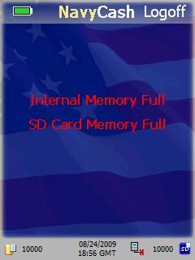
End of Day Procedures
Once a merchant’s business is secured at the end of business day, upload IPA 280/K22 to NC server using following procedures:
- ONLINE Mode, sales transactions are uploaded to NC server automatically.
- OFFLINE Mode, is displayed in corner of screen.
- An will be displayed when transactions have been recorded and need uploading.

Slide 20
EOD Procedures
When IPA 280/K22 is connected to the LAN:
The on the screen disappears.
Upload starts automatically.
The remains displayed until all transactions have been uploaded to the server.
Disconnect IPA 280/K22 from network after disappears.
If IPA 280/K22 gets disconnected while uploading, reconnect it immediately.

Slide 21
Reports

Slide 22
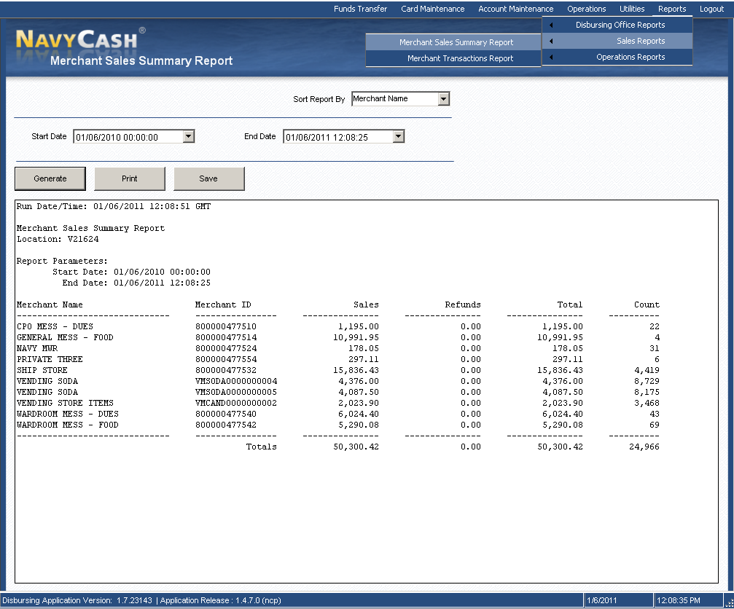
Merchant Sales Summary Report
This report shows a summary of sales, refunds and reversal transactions for each ship merchant.

Slide 23
Shore Report
The following is an example of a Shore report for a particular merchant for troubleshooting ONLY, this report contains private information and should not be submitted with any official documents.
Run Date:12/17/2002
Run Time: 00:12:33
Report Name:TRAN_MWR_D Navy Cash Daily Transaction Detail Report – MORALE WELFARE RECREATION FUND
Location: USS TITAN
Date: 12/15/2002 04:53:25 To 12/16/2002 07:09:45 Batch Id: R22202_971
Last Name First Name SSN Account # Date and Time Value
---------- ----------- ------- ----------- ---------------- -------
BOARDWAY BOARDWALK 7095 9999999961244 12/15/2002 15:04:53 $30.53
GRUBB SCRUBB 3055 9999999938747 12/15/2002 20:33:23 $29.13
LINDEE LANDEE 6054 9999999140790 12/15/2002 20:26:22 $34.73
MANTO TIGER 5839 9999999995721 12/15/2002 20:57:35 $30.53
PAGANO MAGANO 1043 9999999163396 12/15/2002 14:46:22 $34.73
RIVERA RICKY 8209 9999999135550 12/15/2002 20:43:39 $33.28
SLAYDON SLAYER 3901 9999999959867 12/16/2002 02:11:43 $29.13
SLEDGE HAMMER 5038 9999999954488 12/15/2002 20:23:21 $29.13
SNIPES WESLEY 2957 9999999185274 12/15/2002 20:20:25 $31.93
********** *********** ************* ----------
Total Transactions $283.12
*** End of the Report ***

Slide 24
Shore Report
The following is an example of a Shore report for a particular merchant for troubleshooting ONLY, this report contains private information and should not be submitted with any official documents.
Run Date:12/17/2002
Run Time: 00:12:33
Report Name:TRAN_MWR_D Navy Cash Daily Transaction Detail Report – MORALE WELFARE RECREATION FUND
Location: USS TITAN
Date: 12/15/2002 04:53:25 To 12/16/2002 07:09:45 Batch Id: R22202_971
Last Name First Name SSN Account # Date and Time Value
---------- ----------- ------- ----------- ---------------- -------
BOARDWAY BOARDWALK 7095 9999999961244 12/15/2002 15:04:53 $30.53
GRUBB SCRUBB 3055 9999999938747 12/15/2002 20:33:23 $29.13
LINDEE LANDEE 6054 9999999140790 12/15/2002 20:26:22 $34.73
MANTO TIGER 5839 9999999995721 12/15/2002 20:57:35 $30.53
PAGANO MAGANO 1043 9999999163396 12/15/2002 14:46:22 $34.73
RIVERA RICKY 8209 9999999135550 12/15/2002 20:43:39 $33.28
SLAYDON SLAYER 3901 9999999959867 12/16/2002 02:11:43 $29.13
SLEDGE HAMMER 5038 9999999954488 12/15/2002 20:23:21 $29.13
SNIPES WESLEY 2957 9999999185274 12/15/2002 20:20:25 $31.93
********** *********** ************* ----------
Total Transactions $283.12
*** End of the Report ***

Slide 25
Merchant Settlement

Slide 26
Deposits to Commercial Banks
It is very important for the Merchants to understand that funds collected using Navy Cash are NOT immediately available for expenditure from commercial bank accounts.
Options for Merchant settlements:
- To strip or bank account (strip is default).

Slide 27
Navy Cash Cardholder Website
The Navy Cash Cardholder Web Site (www.navycash.com) was developed to help Navy Cash cardholders and merchants manage their Navy Cash accounts. The web site has recently been updated. To log in to the web site, cardholders will need a username and password. The first time cardholders access the updated web site, they use their 16-digit MasterCard® card number and PIN. They are then asked to set up a username and password and set up answers to two security questions. These security questions provide a second layer of authentication, and cardholders must answer these questions each time they log in to the web site from a new computer. It is very important for the Merchants to understand that funds collected using Navy Cash are NOT immediately available for expenditure from commercial bank accounts.

